Slide 1
PYTHON PROGRAMMING
LAUNCHCODE
July 26, 2025
Asfand Khan

Slide 2
Questions + Homework Revie
https://github.com/Asfandyar-Khan/LaunchCode/
Contains syllabus
Contains lectures
Powerpoint files
Google Colab
Contains homeworks
Word document
To be completed prior to class
Any unfinished or challenging questions are taken up at the start of class
Any questions about last week’s homework?

Slide 3
Review of Past Class
Week 2 Homework Review
Variable assignment
Print function
Parameters of the print function
Advanced String and Print Exercises
Using strings
Using numbers
Using a variable in a string
Newline operator
Understanding separator parameter

Slide 4
Knowledge Check
Create three variables:
dogs = 10
cats = 7
birds = 6
Then:
Add them together and store the result in a variable called total_items.
Print this exact message using commas only in the print() function:
You have 10 dogs, 7 cats, and 6 birds. That's 23 items in total!

Slide 5
Knowledge Check
Create three variables:
dogs = 10
cats = 7
birds = 6
Then:
Add them together and store the result in a variable called total_items.
Print this exact message using commas only in the print() function:
You have 10 dogs, 7 cats, and 6 birds. That's 23 items in total!
Three ways of doing this:
Using commas
Using f string
Using .format

Slide 6

Topics to Cover Today
Input Function
What is an input function?
Examples and knowledge check
Chapter 3 – Functions
What is a function?
How is a function called?
What is the syntax of a Python function?
What is a for loop and how is it used in a function?

Slide 7
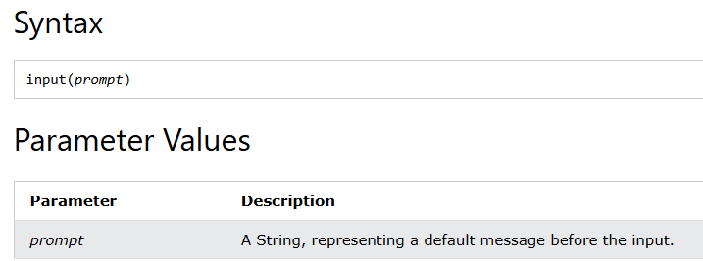
Input Function - Syntax
The input function stores user input into a variable
Can you think of any applications you have used that store user input?

Slide 8
Input Function
Input Instruction: To take an input from user through keyboard input() command is used, this instruction take input from keyboard in the form of ASCII character and store it the variable.
Syntax:
take_input = input(1 Argument)
name = input('Enter your name =')
age = input('Enter your age = ')
print('Your name is ', name , ',and your age is = ',age)

Slide 9
Input Function - Syntax
The input function stores user input into a variable
variable_name: This is where the user's input will be stored. The input() function returns the user's input as a string, and this string is then assigned to variable_name.
input(): This is the built-in Python function used to get input from the user.
"Prompt message (optional)": Optional string (text) that will be displayed to the user before they are prompted to enter input.

Slide 10
Input Function - Syntax
Let’s do some examples in Google Colab!

Slide 11
Knowledge Check
Input Function Review
Use the input function to store three variables. First, ask the user for their name. Then, ask the user how many apples they have. #Then ask how many bananas they have. Then create a variable called total_fruit which adds the user’s total apples and bananas. Finally, use the print function to write the following message: “Bob has 5 apples and 10 bananas and a total of 15 pieces of fruit!”.
Hint: When you ask users for an input of numbers, it is stored as a string. You must convert this input to an int using the int() function.
When you create your total_fruit variable, make sure you use int(apples) and int(bananas) to add the two together.

Slide 12
What is a function?
So far we’ve looked at many different functions
print(), type(), int(), float(), str(), abs(), round()
A function is a sequence of statements that run when it is called
Python has many different built-in functions, like examples above
However, we can build our own functions!

Slide 13
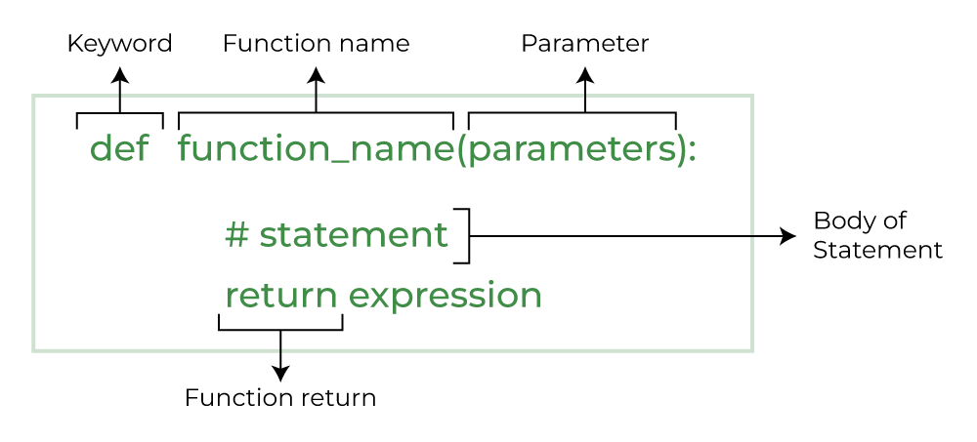
Defining New Functions
Function definition – helps us specify the function
Syntax: Does anyone want to guess what the bottom figure represents?

Slide 14
Defining New Functions, cont’d.
The keyword helps us initialize a function
The function name is the name which you use to call the function
The parameters include the number of variables within the function
The return is the value that comes out of the function
Notice the syntax/structure of how we name functions!

Slide 15
Defining New Functions, Example
Write a function that outputs a few of the introductory sentences we covered earlier in the class
def favourite_sentences():
print(“My name is Bob”)
print(“My age is 10”)

Slide 16
Functions - Parameters
def print_twice(string):
print(string)
print(string)
Notice how string is now added as a parameter
How does this function work?
What will happen if you call this function?
Can this function be called without any input?

Slide 17
Functions – Multiple Parameters
def repeat(word,n):
print(word*n)
There are now two parameters in our function
What will be the output of this function?
Does anyone want to demonstrate?

Slide 18
Functions – For Loops
A for loop iterates over a sequence – such as a string, list, or tuple
Allows you to run a block of code repeatedly
This occurs once for each item in the sequence
Syntax:
for item in iterable:
# Code to be executed for each item

Slide 19
Review and Questions
Homework will be posted tomorrow!
Asfand Khan

